Slide 1
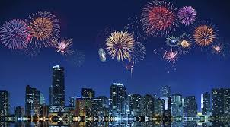
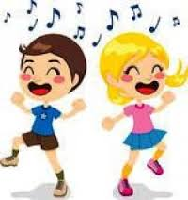
Unit 9 Festivals
732
1.
4.
a) Seventy thirty two c) Seven hundred thirteen
b) Seventy three two d) Seven hundred thirty two
a) Firework c) Candle
b) Costume d) Cookie
Selami:………………………….?
Şahin: It is Ramadan feast.
2. Which of the following completes the conversation?
a) What is your nationality?
b) What is your favorite festival?
c) How do you celebrate Ramadan feast?
d) Do you like festivals?
Necip: When do you celebrate Youth and Sports day?
Fazıl:……………………….
5. Which of the following completes the conversation?
a)You are welcome.
b) I’m so excited.
c) On 19th May.
d) I like Youth and Sports day.
@kingilizce
We celebrate it on 23rd of April every year. We read poems, sing songs, dance, do acrobatics and other performances and have lots of fun on this day.
3. Read the text and choose the correct answer.
a) Children’s Day c) Republic Day
b) Victory Day d) Independence day
6. What are they doing?
a) They are playing soccer.
b) They are singing and dancing.
c) They are carving a pumpkin.
d) They are wearing costumes.
www.kingilizce.com İngilizce Eğitim Sitesi www.okuling.com Eğitim Materyalleri

Slide 2
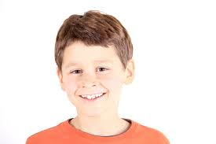
Unit 9 Festivals
Read the speech bubble and answer the question
Hello, I’m Jack.I’m eleven old. I’m from the USA.I watch the great firework show on the Independence Day.
Safiye:……………………….?
Faik: We sing songs, read poems, dance and do
different performances.
9. Which of the following completes the conversation?
a) How do you celebrate Children’s Day?
b) What is your favorite festival?
c) When do you celebrate Children’s Day?
d) Do you like festivals?
7.Which of the following question has No answer in the speech bubble?
a) How old is Jack?
b) What festival does he celebrate?
c) Where is he from?
d) Does he like festivals?
Cahit: …………………..?
Sıtkı: My name is Sıtkı.
Cahit: …………………..?
Sıtkı: I’m 25 years old.
Cahit: …………………..?
Sıtkı:Yes, I do.
Cahit: Thank you very much.
Sıtkı: You are welcome.
10. Which of the following does NOT complete the conversation?
a) Do you like festival?
b) Can I ask you a question?
c) How old are you?
d) What is your name?
@kingilizce
Ahmet: How long is Ramadan feast?
Haşim:…………………..
8.Which of the following completes the conversation?
a) It is my favorite feast.
b) I like Ramadan feast.
c) It is a three - day feast.
d) I visit my relatives.
www.kingilizce.com İngilizce Eğitim Sitesi www.okuling.com Eğitim Materyalleri

Slide 3
Unit 9 Festivals
Answer Key
1- D
2- B
3- A
4- A
5- C
6- B
7- D
8- C
9- A
10- B
@kingilizce
www.kingilizce.com İngilizce Eğitim Sitesi www.okuling.com Eğitim Materyalleri

